Slide 1
MLOps Utility for Real-Time Data Drift & Quality Monitoring
Yash Gupta – Data Scientist

Slide 2
ML Model Degradation: Unveiling the Hidden Challenges
Reduced Model Accuracy
Model performance decreases visibly.
Feature Drift
Input data distribution changes over time.
Data Pipeline Errors
Inconsistencies introduce noise into the data.
Concept Drift
Relationship between inputs and outputs evolves.
Monitoring Fragmentation
Manual monitoring delays problem detection.
Biased Outcomes
Model degradation leads to unfair predictions.

Slide 3
DataDriftSDK: Features
Drift Metrics
Drift Scores
Export Results
Calculates detailed data drift metrics using Evidently AI.
Generates per- feature and aggregate dataset drift scores.
Exports results in a platform-agnostic way.
Data Formats
Configuration
Proactive Detection
Supports multiple data formats for versatile ingestion.
Configurable statistical methods and drift thresholds.
Enables proactive detection of problematic data shifts.

Slide 4
DataQualitySDK Delivers Comprehensive Data Profiling
Compute essential data metrics
Calculate Metrics
Distinguish numerical and categorical data
Identify Feature Types
Collect unique and common values
Capture Unique Values
Organize data in a consistent schema
Store Results
Output data in Delta or CSV formats
Export Profiles

Slide 5
Optimizing Model Performance with ModelMonitoringSDK
Evaluates ML model performance for classification and regression tasks with metrics like Accuracy, F1-Score, RMSE, and R²
Seamlessly integrates with MLflow and Pickle model artifacts to fit diverse ML workflows
Employs SHAP values to deliver clear model explainability and interpret complex predictions
Correlates performance metrics with feature drift detected by DataDriftSDK to uncover impact drivers
Exports results to CSV or Databricks Delta tables for unified tracking of model behavior and data shifts
Enables enhanced interpretability and governance by tracking model metrics alongside detected data drift

Slide 6
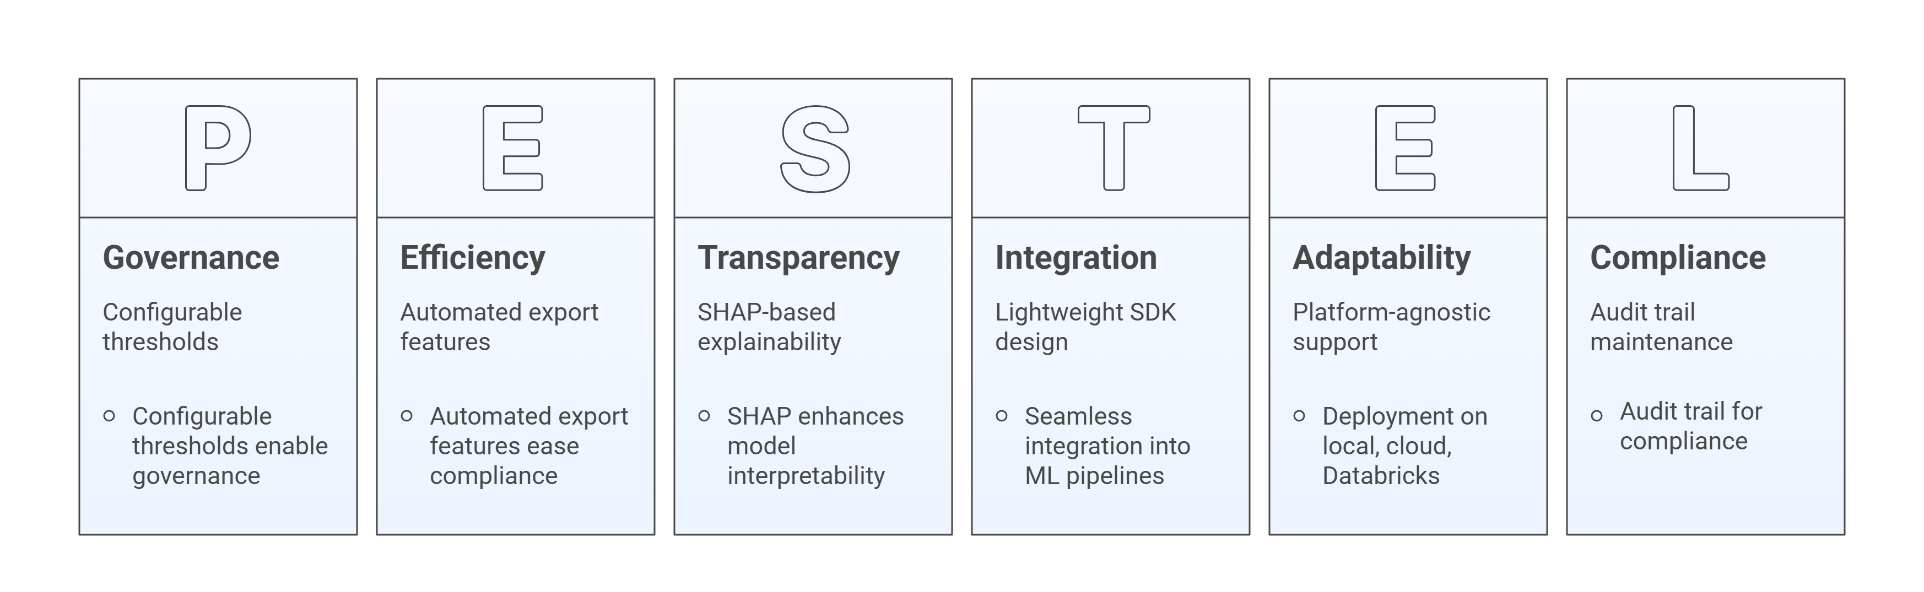
Comprehensive Monitoring Utility Advantages

Slide 7
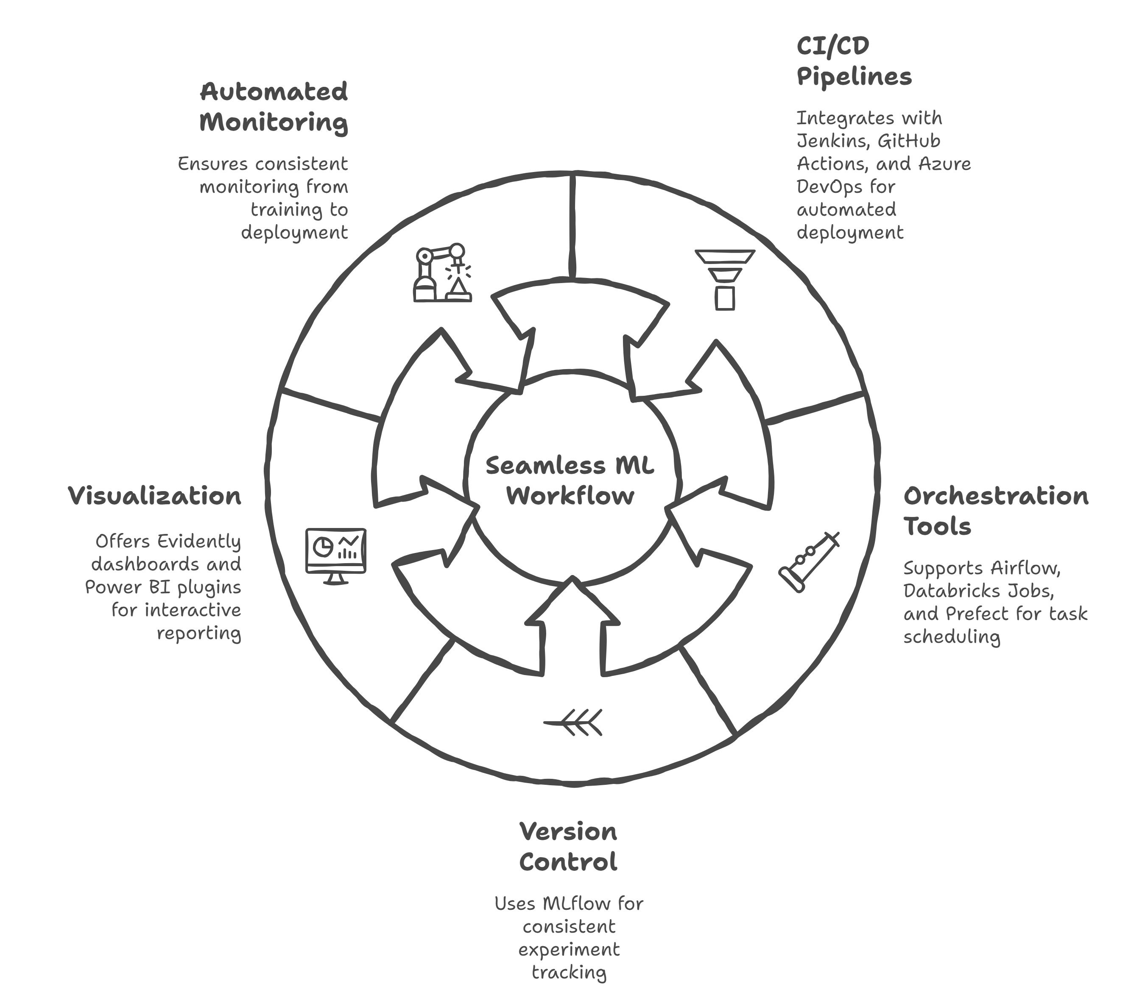
Seamless Integration Across ML Workflows

Slide 8
Driving Scalable, Transparent, and Compliant ML Operations
Provides a robust and scalable foundation for high-quality ML operations
Integrates data drift detection, data quality profiling, and model performance tracking
Enables teams to proactively manage model reliability and regulatory compliance
Offers a platform-agnostic, modular SDK design compatible with diverse environments
Supports delivery of trustworthy, efficient ML systems aligning with evolving business needs

Slide 9
Platform - Agnostic Design: Flexible Multi - Environment Support
Platform
Support Type
Data Export Formats
Integration Mode
Automated environment detection and I/O handling
Smooth integration into existing CI/CD pipelines
Local Systems
CSV, Parquet
Auto-detects environment for optimized data operations
Platform-neutral deployment enabling flexible workflows
Databricks with Unity Catalog
Delta tables
Environment-aware I/O management
Easy integration without platform lock-in
AWS Redshift
SQL, CSV
Custom environment detection and adaptable handling
Supports diverse organizational infrastructures
On-premises & Custom Cloud
CSV, Parquet, SQL

Slide 10
Transforming Operations with Automation
Task | Before Automation | After Automation
Data Drift Detection | Manual SQL queries and visual analysis | Automated detection using Evidently AI
Quality Validation | Ad-hoc scripts | Continuous profiling integrated in monitoring
Model Monitoring | Manual metric tracking with limited environment support | Unified tracking via MLflow, SHAP, and drift insights
Environment Compatibility | Limited | Platform - Agnostic supports local, cloud, and Databricks
Metric Export & Aggregation | Manual aggregation | Automated metric export streamlining workflows
Model Reliability & Governance | Challenging due to manual processes | Enhanced through automation and unified tracking

Slide 11
Continuous Monitoring for Reliable Machine Learning
Automates detection of data drift, ensuring model relevance in production
Monitors data quality metrics continuously to maintain integrity
Tracks comprehensive model performance metrics to assess accuracy and fairness
Supports multiple data formats and integrates with MLflow, pickle artifacts, and data pipelines
Enables real-time observability and governance for proactive feature shift detection
Exports consolidated monitoring reports facilitating transparency and regulatory compliance
Ensures sustained trust and compliance in automated decision-making systems

Slide 12
Future Scope: Expanding Monitoring Capabilities
Feature Area | Planned Enhancements | Value / Benefits
Concept Drift Detection | Advanced methods: Kolmogorov–Smirnov, PSI, MMD | Improves detection accuracy for model aging and distribution shifts
Real-Time Alerts | Integration with Slack and Teams for anomaly notifications | Enhances responsiveness and proactive issue resolution
Visualization Dashboard | Power BI and Evidently UI integration layer | Delivers intuitive data and drift insights for stakeholders
Automated Retraining | Pipelines triggered by drift thresholds | Streamlines model maintenance and reduces manual intervention
Schema Evolution Monitoring | Track changes in data schema over time | Ensures data integrity and compatibility with model inputs
Support for Complex Models | Extend monitoring to time-series and deep learning models | Broadens applicability to diverse ML operational needs

Slide 13
Thank You!!!

Slide 14
Future Scope: Expanding Monitoring Capabilities
Feature Area | Planned Enhancements | Value / Benefits
Concept Drift Detection | Advanced methods: Kolmogorov–Smirnov, PSI, MMD | Improves detection accuracy for model aging and distribution shifts
Real-Time Alerts | Integration with Slack and Teams for anomaly notifications | Enhances responsiveness and proactive issue resolution
Visualization Dashboard | Power BI and Evidently UI integration layer | Delivers intuitive data and drift insights for stakeholders
Automated Retraining | Pipelines triggered by drift thresholds | Streamlines model maintenance and reduces manual intervention
Schema Evolution Monitoring | Track changes in data schema over time | Ensures data integrity and compatibility with model inputs
Support for Complex Models | Extend monitoring to time-series and deep learning models | Broadens applicability to diverse ML operational needs

Slide 15
Platform - Agnostic Design: Flexible Multi - Environment Support
Platform | Support Type | Data Export Formats | Integration Mode
Local Systems | Automated environment detection and I/O handling | CSV, Parquet | Smooth integration into existing CI/CD pipelines
Databricks with Unity Catalog | Auto-detects environment for optimized data operations | Delta tables | Platform-neutral deployment enabling flexible workflows
AWS Redshift | Environment-aware I/O management | SQL, CSV | Easy integration without platform lock-in
On-premises & Custom Cloud | Custom environment detection and adaptable handling | CSV, Parquet, SQL | Supports diverse organizational infrastructures

Slide 16
Comprehensive Metrics Tracking for Robust Governance
Metric Type | Source/SDK | Tracked Elements | Governance Purpose
Data Drift Metrics | Evidently AI (DataDriftSDK) | Shifts in input distributions | Detects data input variations impacting model validity
Data Quality Metrics | DataQualitySDK | Missingness, Variance | Monitors data integrity and consistency
Model Performance Metrics | ModelMonitoringSDK | Accuracy, Recall, RMSE, SHAP importances | Evaluates model effectiveness and explains feature impact
Operational Metrics | Local logs / Spark | Runtime, Frequency | Tracks execution details supporting operational oversight
Record Attributes | All Systems | Timestamp, Model Name, Metric Scores, Drifted Feature Counts, Environment Info | Supports governance dashboards and automated retraining triggers

Slide 17
Stakeholders Empowered by Monitoring
Data Scientists monitor feature drift and model accuracy in real time to maintain model performance.
MLOps Engineers automate retraining triggers and build governance dashboards for streamlined model management.
Data Engineers ensure pipeline data quality and reliability, validating inputs for robust ML workflows.
Business Analysts translate monitoring results into actionable insights linked to KPIs and business goals.
Compliance Teams verify auditability, fairness, and regulatory documentation to maintain ethical standards.
This cross-functional targeting fosters collaboration and shared responsibility for sustained ML system health.

Slide 18
Driving Scalable, Transparent, and Compliant ML Operations
Provides a robust and scalable foundation for high-quality ML operations
Integrates data drift detection, data quality profiling, and model performance tracking
Enables teams to proactively manage model reliability and regulatory compliance
Offers a platform-agnostic, modular SDK design compatible with diverse environments
Supports delivery of trustworthy, efficient ML systems aligning with evolving business needs

Slide 19
Seamless Integration Across ML Workflows
Integrates with popular CI/CD pipelines including Jenkins, GitHub Actions, and Azure DevOps
Supports orchestration tools like Airflow, Databricks Jobs, and Prefect for scheduling monitoring tasks
Version control integration via MLflow ensures consistent experiment tracking and artifact management
Offers visualization through Evidently dashboards and Power BI plugins for insightful, interactive reporting
Ensures consistent, automated monitoring spanning from model training to production deployment

Slide 20
Modular SDKs Simplifying MLOps Monitoring
SDK Component | Purpose | Outputs
DataDriftSDK | Detects distribution shifts between training and scoring datasets | Drift metrics indicating data distribution changes
DataQualitySDK | Profiles key data quality metrics including missing values and outliers | Data quality reports highlighting anomalies
ModelMonitoringSDK | Evaluates classification and regression models with metrics and SHAP explainability integrating drift insights | Model performance metrics & explainability integrated with drift data

Slide 21
Comprehensive Monitoring Utility Advantages
End-to-end monitoring covering data drift, data quality, and model performance within a single platform
Platform-agnostic support enabling deployment on local, cloud, and Databricks environments
Configurable thresholds that enable governance and alerting without requiring code changes
SHAP-based explainability to enhance model transparency and interpretability
Automated export features centralizing reporting and easing compliance workflows
Lightweight SDK design facilitating seamless integration into existing ML pipelines
Audit trail maintenance critical for compliance and traceability
Extensibility allowing addition of new drift tests or quality metrics to meet evolving needs

